Slide 1
Foundation of computing
team 4

Slide 2
MATRIX OPERATION TOOL
TEAM MEMBERS:
HARINI S
HINDHU PRIYA M
INIYHA D K
JAI AKASH E [LEADER]
JANANISREE S

Slide 3
Flow chart
A flowchart is a visual diagram that uses standardized symbols and arrows to represent a process, workflow, or algorithm. It breaks down complex sequences into a series of logical steps, making it easier to understand, document, and improve processes. Common symbols include ovals for start/end, rectangles for processes, and diamonds for decisions.

Slide 4
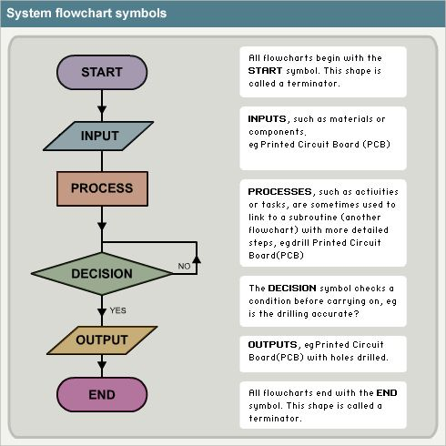
Flow chart symbols and meanings:

Slide 5
Algorithm
An algorithm is a step-by-step set of instructions or rules to solve a problem or perform a task, converting an input into a desired output. Like a recipe, it provides a precise procedure that can be followed by a human or, more commonly, a computer to achieve a consistent and reliable result. Algorithms are fundamental to computer science and are used in everything from simple calculations to complex operations like traffic navigation, personalized recommendations, and data processing.

Slide 6
How algorithms work
Input:
Algorithms begin with one or more specific inputs, which is the data to be processed.
Processing:
A series of well-defined, logical steps are performed on the input data. These steps can involve simple operations, decision-making (branching), or repetition (loops).
Output:
The algorithm produces a result or a solution based on the input and the executed steps.

Slide 7
Key characteristics
Definiteness: Each step is clear and unambiguous, leaving no room for interpretation.
Finiteness: An algorithm will always finish after a limited number of steps.
Effectiveness: Each instruction must be basic enough to be carried out in practice.
Input/Output: There are zero or more well-defined inputs and one or more well-defined outputs.

Slide 8
Real-world examples
Navigation apps:
Use algorithms to find the fastest route between two points, factoring in traffic and road closures.
Social media:
Employ algorithms to curate your feed, showing you content based on your past activity and interests.
Search engines:
Use proprietary algorithms to rank websites and provide relevant results for your search queries.

Slide 9
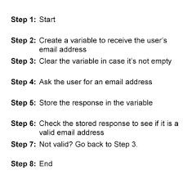
Algorithm example:

Slide 10
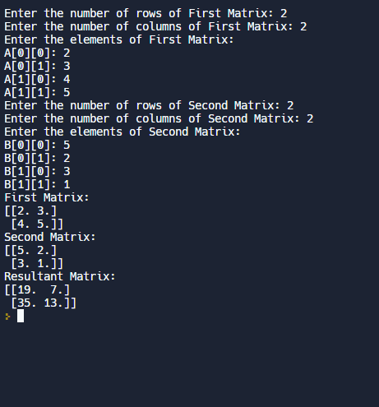
Example program:

Slide 11
Output for the program:
First Matrix:
[2. 3.]
[4. 5.]
Second Matrix:
[5. 2.]
[3. 1.]
Resultant Matrix:
[19. 7.]
[35. 13.]

Slide 12


